Slide 1
Microservices and DevOps
DevOps and Container Technology
Swarm Deployment
Henrik Bærbak Christensen

Slide 2
So…
Deliver = Deploy Release in Production
When
Human gate: When I say ‘go’
Human gate: When canaries have survived N hours
Automatic: Final stage of the deployment pipeline
Push based: Execute commands to deliver
E.g. call the ‘deployment interface’ with (version, production, service)
Pull based: Just flag version to publish
E.g. cron job on production server that monitor flag

Slide 3
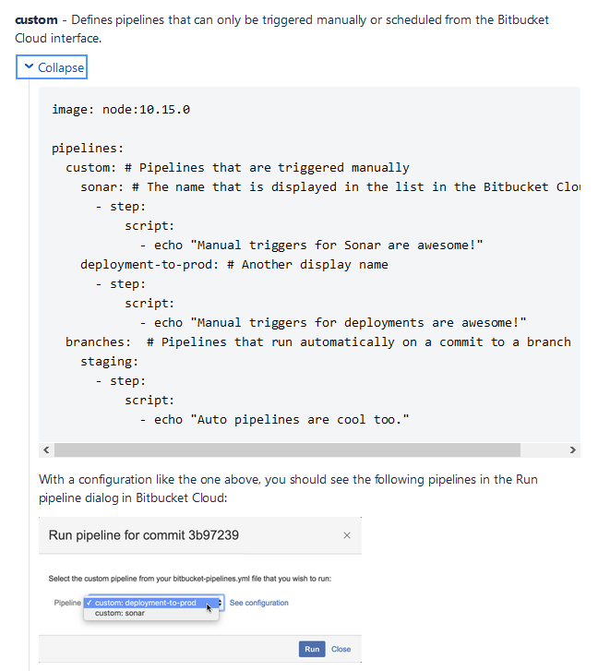
BitBucket Pipelines
Define human gates

Slide 4
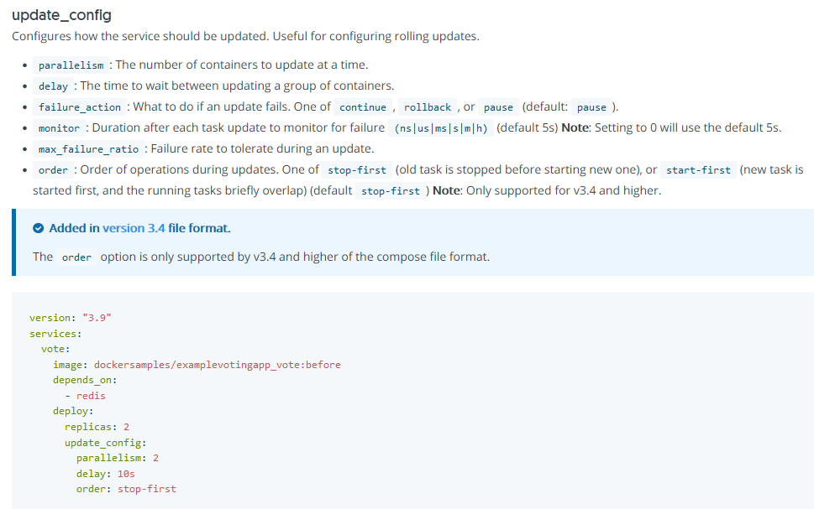
Swarm: update_config

Slide 5
Exercise
Can we define:
Blue/green
Canary
Rolling

Slide 6
Discussion
Experience in the audience?
The Return on Investment
Balancing effort on complex ‘deployment interfaces’ development versus roll out schedule and monitoring

